Slide 1




Value of a music manager
Calculating the value of managers in the UK music industry – Dr Ruth Melville, RMR

Slide 2



About this research
Aim: calculate the value managers bring to the UK music industry.
Challenges:
Complexity of managers’ role in the industry – work across the different sub-sectors
Impact ripples out to include the wider industry and, ultimately, music fans and the wider public.
Imagine a scenario where managers disappear overnight … what would be needed to fill the gap left? additional time, resources, knowledge …
Options appraisal – agreed Social Return on Investment Analysis approach - direct financial value and includes measuring indirect impacts to arrive at a full figure for the value.
Developed and tested model with an expert panel of industry stakeholders and a range of music-makers
Used a mix of data from interviews, surveys and secondary research to value and validate our findings.

Slide 3
About the research team
JEM Associates help people, projects and organisations understand and increase their social impact.
Director, Jael Williams, (jaelwilliams@jemassociates.org) Social Value International SROI accredited practitioner with over 25 years’ experience of strategy, impact, participation and change work.
the hub is a leading development force in the UK music sector. Combining practice with consultancy, they use consultancy proceeds to seed fund our in-house ‘hub lab’ sector development work.
Director and Co-Founder, Julia Payne (julia@thehubuk.com).works with clients and partners ranging from the biggest names in the creative sector – from PlayStation to the BBC – to music industry bodies, funders and individual music venues and festivals.
RM Research are people-centred strategy, research and evaluation specialists.
They help organisations understand what they do, the difference they make, and what they can do better.
Director, Dr. Ruth Melville (ruth@rmresearch.uk), is an experienced social researcher who has advised UK government and international cultural organisations on best research practice.

Slide 4

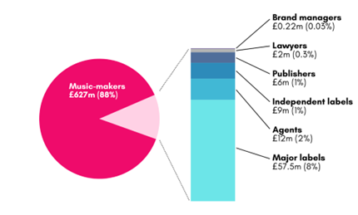

The difference to the UK music industry
Total value that music managers create for the UK music industry, each year
A return of 1:8 on the £88 million of direct investment made in managers each year.
Notes:
Our research indicates that the difference that music managers make to the UK music industry (music-makers, major and independent labels, agents, publishers, lawyers and brand partnership) is valued at £714 million (£713,796,874) each year.
Based on the £88 million of direct investment made in managers each year, the return on that investment is 1:8. Each year, the difference made to the music-makers that managers work with is valued at £627 million (£627,335,876), and to other industry stakeholders £86 million (£86,545,492).

Slide 5

The difference to industry stakeholders
Based on our research, the difference that managers make each year to industry peers is valued at a minimum of £86 million (£86,545,492).
What does this look like?
Increased efficiency, resulting in increased income and productivity, is the major outcome from working with music managers
Working with managers can save them at least 1-1.5 days a week.
Managers are likely to increase overall industry outputs through these stakeholders by between 48% and 72%.
Notes:
Alongside music-makers, our research also explored the difference managers make to other industry stakeholders: major and independent labels, agents, publishers, lawyers and brand partnership managers. These are impacts that are often overlooked, and that have never been measured in the UK.
Based on our research, the difference that managers make each year to these industry peers is valued at a minimum of £86 million (£86,545,492).
This value relates to the impact managers have on efficiency, connectivity and stress levels
The majority of music-makers that the wider industry stakeholders we consulted work with do have managers – and, if they don’t initially, they are quickly advised to appoint one. Over 90% of all music-makers that labels work with have managers, as do 80% of those that publishers work with, 75% of those that lawyers work with and 60% of those that agents work with.
These industry stakeholders identified increased understanding and efficiency, resulting in increased income and productivity, as the major outcome from working with music managers, and indicated that working with managers can save them at least 1-1.5 days a week. Our research also shows that managers are likely to increase overall industry outputs through these stakeholders by between 48% and 72%.
In addition, our research highlighted two other manager-related outcomes for music-makers and wider stakeholders: firstly, they are better connected across the industry and, secondly, they have lower stress levels. Those we consulted on average scored the former outcome at 8/10 in terms of the impact it has on them, and the latter 9/10⁴.
This ‘value chain’ diagram illustrates the inputs these industry stakeholders described managers as making, alongside the resulting measurable outcomes⁵. Our research shows that the value chains are the same for each industry stakeholder, although the actual valuations for end outcomes differ.

Slide 6
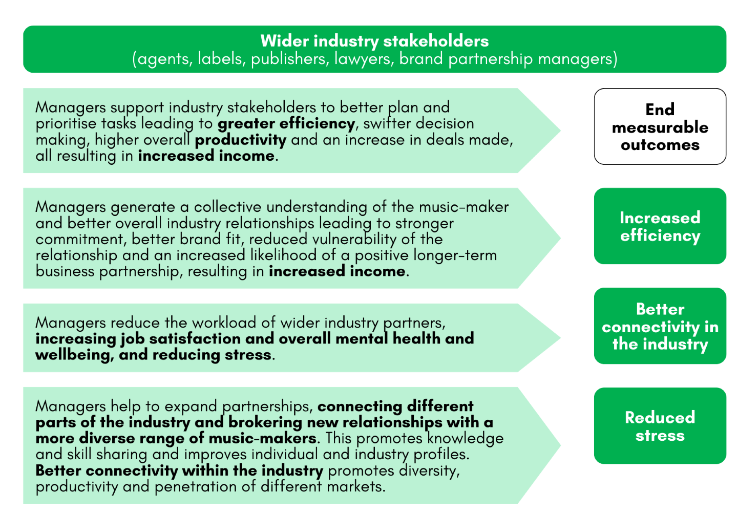
Notes:
Alongside music-makers, our research also explored the difference managers make to other industry stakeholders: major and independent labels, agents, publishers, lawyers and brand partnership managers. These are impacts that are often overlooked, and that have never been measured in the UK.
Based on our research, the difference that managers make each year to these industry peers is valued at a minimum of £86 million (£86,545,492).
This value relates to the impact managers have on efficiency, connectivity and stress levels
The majority of music-makers that the wider industry stakeholders we consulted work with do have managers – and, if they don’t initially, they are quickly advised to appoint one. Over 90% of all music-makers that labels work with have managers, as do 80% of those that publishers work with, 75% of those that lawyers work with and 60% of those that agents work with.
These industry stakeholders identified increased understanding and efficiency, resulting in increased income and productivity, as the major outcome from working with music managers, and indicated that working with managers can save them at least 1-1.5 days a week. Our research also shows that managers are likely to increase overall industry outputs through these stakeholders by between 48% and 72%.
In addition, our research highlighted two other manager-related outcomes for music-makers and wider stakeholders: firstly, they are better connected across the industry and, secondly, they have lower stress levels. Those we consulted on average scored the former outcome at 8/10 in terms of the impact it has on them, and the latter 9/10⁴.
This ‘value chain’ diagram illustrates the inputs these industry stakeholders described managers as making, alongside the resulting measurable outcomes⁵. Our research shows that the value chains are the same for each industry stakeholder, although the actual valuations for end outcomes differ.

Slide 7


Breaking the economic impact down
Major record labels in the UK
Independent record labels in the UK
Outside the earnings of such labels from the music-makers on their rosters and what the managers are paid, managers generate an additional £57 million (£57,474,984) of economic impact for the UK’s three major labels. The key measurable outcome for major labels is increased efficiency.
Outside earnings from music-makers on their rosters for independent labels and what managers are paid, managers generate additional economic impact of just under £8.9 million (£8,863,256) for the UK’s estimated 500 independent record labels and distributors. The key measurable outcome for these independent labels and distributors is also increased efficiency.
Notes:
Major record labels in the UK
Our research indicates that outside the earnings of such labels from the music-makers on their rosters and what the managers are paid, managers generate an additional £57 million (£57,474,984) of economic impact for the UK’s three major labels. The key measurable outcome for major labels is increased efficiency.
2. Independent record labels in the UK
Similarly, besides earnings from music-makers on their rosters for independent labels and what managers are paid, managers generate additional economic impact of just under £8.9 million (£8,863,256) for the UK’s estimated 500 independent record labels and distributors. The key measurable outcome for these independent labels and distributors is also increased efficiency.
3. Live music agents in the UK
Aside from earnings for agents gained from music-makers on their rosters and what managers are paid, managers generate an additional £12 million (£12,496,716) social and economic impact for the UK’s 500 live music agents. The key measurable outcomes for such agents are again increased efficiency, plus better connectivity within the industry and reduced stress.
4. Music publishers in the UK
Besides earnings for publishers from music-makers with whom they work and what managers are paid; managers generate an additional £5.9 million (£5,960,110) of social and economic impact for the UK’s 200 music publishers. The key measurable outcomes for them are again increased efficiency, plus better connectivity within the industry and reduced stress.
5. Music lawyers in the UK
Outside lawyers’ earnings from music-makers with whom they work and what managers are paid; managers generate an additional £2 million (£1,979,935) of social and economic impact for the UK’s 73 specialist music lawyers ranked on Chambers . The key measurable outcomes for them are again increased income efficiency, plus better connectivity within the industry and reduced stress.
6. Brand partnership managers in the UK
Outside of the benefit gained from partnerships brand partnership managers have with music-makers with whom they work and what the managers are paid, managers generate an additional £0.22 million (£224,406) of social and economic impact for the 10 main brand partnership managers working in the UK music industry. The key measurable outcomes for them are again increased efficiency, plus better connectivity within the industry and reduced stress.

Slide 8


Breaking the economic impact down
Live music agents in the UK
Music publishers in the UK
Aside from earnings for agents gained from music-makers on their rosters and what managers are paid, managers generate an additional £12 million (£12,496,716) social and economic impact for the UK’s 500 live music agents. The key measurable outcomes for such agents are again increased efficiency, plus better connectivity within the industry and reduced stress.
Besides earnings for publishers from music-makers with whom they work and what managers are paid; managers generate an additional £5.9 million (£5,960,110) of social and economic impact for the UK’s 200 music publishers. The key measurable outcomes for them are again increased efficiency, plus better connectivity within the industry and reduced stress.
Notes:
Major record labels in the UK
Our research indicates that outside the earnings of such labels from the music-makers on their rosters and what the managers are paid, managers generate an additional £57 million (£57,474,984) of economic impact for the UK’s three major labels. The key measurable outcome for major labels is increased efficiency.
2. Independent record labels in the UK
Similarly, besides earnings from music-makers on their rosters for independent labels and what managers are paid, managers generate additional economic impact of just under £8.9 million (£8,863,256) for the UK’s estimated 500 independent record labels and distributors. The key measurable outcome for these independent labels and distributors is also increased efficiency.
3. Live music agents in the UK
Aside from earnings for agents gained from music-makers on their rosters and what managers are paid, managers generate an additional £12 million (£12,496,716) social and economic impact for the UK’s 500 live music agents. The key measurable outcomes for such agents are again increased efficiency, plus better connectivity within the industry and reduced stress.
4. Music publishers in the UK
Besides earnings for publishers from music-makers with whom they work and what managers are paid; managers generate an additional £5.9 million (£5,960,110) of social and economic impact for the UK’s 200 music publishers. The key measurable outcomes for them are again increased efficiency, plus better connectivity within the industry and reduced stress.
5. Music lawyers in the UK
Outside lawyers’ earnings from music-makers with whom they work and what managers are paid; managers generate an additional £2 million (£1,979,935) of social and economic impact for the UK’s 73 specialist music lawyers ranked on Chambers . The key measurable outcomes for them are again increased income efficiency, plus better connectivity within the industry and reduced stress.
6. Brand partnership managers in the UK
Outside of the benefit gained from partnerships brand partnership managers have with music-makers with whom they work and what the managers are paid, managers generate an additional £0.22 million (£224,406) of social and economic impact for the 10 main brand partnership managers working in the UK music industry. The key measurable outcomes for them are again increased efficiency, plus better connectivity within the industry and reduced stress.

Slide 9


Breaking the economic impact down
Music lawyers in the UK
Brand partnership managers in the UK
Outside lawyers’ earnings from music-makers with whom they work and what managers are paid; managers generate an additional £2 million (£1,979,935) of social and economic impact for the UK’s 73 specialist music lawyers ranked on Chambers . The key measurable outcomes for them are again increased income efficiency, plus better connectivity within the industry and reduced stress.
Outside of the benefit gained from partnerships brand partnership managers have with music-makers with whom they work and what the managers are paid, managers generate an additional £0.22 million (£224,406) of social and economic impact for the 10 main brand partnership managers working in the UK music industry. The key measurable outcomes for them are again increased efficiency, plus better connectivity within the industry and reduced stress.
Notes:
Major record labels in the UK
Our research indicates that outside the earnings of such labels from the music-makers on their rosters and what the managers are paid, managers generate an additional £57 million (£57,474,984) of economic impact for the UK’s three major labels. The key measurable outcome for major labels is increased efficiency.
2. Independent record labels in the UK
Similarly, besides earnings from music-makers on their rosters for independent labels and what managers are paid, managers generate additional economic impact of just under £8.9 million (£8,863,256) for the UK’s estimated 500 independent record labels and distributors. The key measurable outcome for these independent labels and distributors is also increased efficiency.
3. Live music agents in the UK
Aside from earnings for agents gained from music-makers on their rosters and what managers are paid, managers generate an additional £12 million (£12,496,716) social and economic impact for the UK’s 500 live music agents. The key measurable outcomes for such agents are again increased efficiency, plus better connectivity within the industry and reduced stress.
4. Music publishers in the UK
Besides earnings for publishers from music-makers with whom they work and what managers are paid; managers generate an additional £5.9 million (£5,960,110) of social and economic impact for the UK’s 200 music publishers. The key measurable outcomes for them are again increased efficiency, plus better connectivity within the industry and reduced stress.
5. Music lawyers in the UK
Outside lawyers’ earnings from music-makers with whom they work and what managers are paid; managers generate an additional £2 million (£1,979,935) of social and economic impact for the UK’s 73 specialist music lawyers ranked on Chambers . The key measurable outcomes for them are again increased income efficiency, plus better connectivity within the industry and reduced stress.
6. Brand partnership managers in the UK
Outside of the benefit gained from partnerships brand partnership managers have with music-makers with whom they work and what the managers are paid, managers generate an additional £0.22 million (£224,406) of social and economic impact for the 10 main brand partnership managers working in the UK music industry. The key measurable outcomes for them are again increased efficiency, plus better connectivity within the industry and reduced stress.

Slide 10


The difference to music-makers
The difference that managers make to music-makers amounts to £627 million each year
This value relates to the impact managers have on music-maker earnings, self-belief and stress
For every £1 music-makers spend on manager commission, they get a minimum return of £7.19
Notes:
The difference that managers make to music-makers amounts to £627 million each year
Unsurprisingly, of all those who work in the UK music industry it’s music-makers who managers make the most difference to. Based on our research, the difference that managers make each year to the music-makers they work with is valued at £627 million (£627,335,876).
For every £1 music-makers spend on manager commission, they get a minimum return of £7.19
Via the commission they pay, music-makers are the main investors in managers. Based on our research, the average total commission paid by music-makers to managers each year is just over £87 million (£87,210,109).
In the UK, commission is generally based on managers receiving 20% of music-maker earnings – equivalent to music-makers getting £4 return for every £1 spent. Our research shows that the actual return on investment is almost double this, as for every £1 that a music-maker spends on manager commission fees they in fact get a much higher return of £7.19 in economic and social value. Were this added value to be reflected in manager commission, the rate would need to increase from 20% to 36%.
This value relates to the impact managers have on music-maker earnings, self-belief and stress
Looking more forensically at the £627m value generated by managers for the music-makers with whom they work, our research indicates that the majority of this – 82% - relates to increased and more secure income, with a further 13% relating to reductions in stress and 5% to increased self-belief.
UK Music data from the past two years provides evidence of the economic impact managers have on the music-makers. This data indicates music-makers with a manager earn more than twice those without management; the former earning on average £43,938 each year, and the latter just £18,9042.
Feedback from participating music-makers indicates they readily acknowledge the economic impact managers can have. However, they place much more emphasis on the strength of their relationships with, and the impact that managers have, in terms of building their self-belief, reducing stress, creating a sense of belonging and ultimately making music-makers feel more empowered, both creatively and in more general terms.

Slide 11
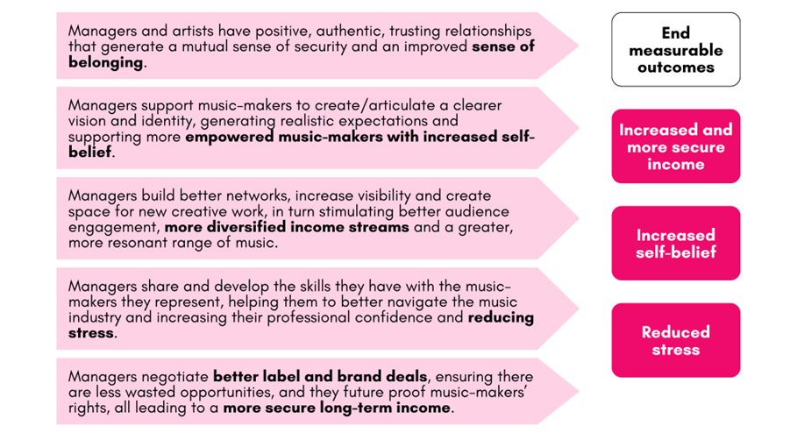
Please see full methodology appendicesfor a more detailed illustration of the full value chain developed from our interviews with artists. ​
Notes:
This ‘value chain’ diagram illustrates the inputs these music-makers described managers as making, alongside the measurable outcomes these result in³.

Slide 12
So what?
This research shows a previously uncalculated and unrecognised value that is being generated by music managers
This impacts on music makers and the wider sector, with wider ripples – this research only focusses on the centre
Our research shows that the likely ‘value’ is much higher.
The current commission-based business model does not recognise this and potentially has knock on negative effects on the sustainability of the sector overall.
A better and more strategic investment into managers (a more effective business model for the 21st Century and increased professional development opportunities) is necessary if the industry as a whole is serious about long term resilience.

Slide 13
Thank you
For further details, please email:
Dr Ruth Melville
(ruth@rmresearch.uk)
Or Jael Williams (jaelwilliams@jemassociates.org)

